Slide 1
Java Full Stack Developer Cohort
“The most reliable way to predict the future is to create it”
– Abraham Lincoln

Slide 2


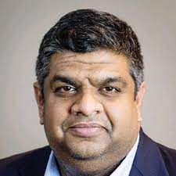
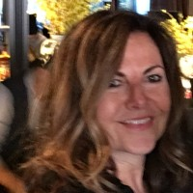
Covering Letter
Fannie Mae Team,
With a high degree of confidence, we are presenting our current cohort of Java FS Developers for this opportunity to partner with you and your colleagues. Speaking on behalf of our colleagues and partners at Revature, we are humbled and appreciate the opportunity to work with you. We have a proud history of partnering with Fannie Mae, having placed 52 associates in the last 12 months and our associates are delighted to be working for your organization.
In the words of General James Mattis, great organizations “Recruit for attitude and train for skill.” Revature lives up to that credo every day in our efforts to create opportunities for associates that only lack visibility into professional opportunities and personal growth and do not have exposure to great organizations like Fannie Mae. Our diversity and inclusion initiatives flow naturally as part of that mission.
We are incredibly proud of our training program that creates the next generation of Software Engineers through a unique project-based approach. Our pedagogy enables these fantastic individuals to be ready for the job, and it makes them continuous learning individuals to adapt to new technologies with ease. Just listen to some of our past associates explain their training experience in this video.
Our Java FS curriculum has evolved over the years based on feedback from our customers and industry experts. The focus of this curriculum is to provide the associate with the required knowledge and practical experience required to be productive from week ONE on the project. We have included a copy of the curriculum used for this training in this document. For your reference, these associates are currently in week 7 of the training program.
Sincerely,
Balu Sudhakar Prasad Taiwade Alexa Gilroy
Head of Customer Success BFSI Market Unit Leader Account Director – Fannie Mae
2

Slide 3
Profiles

Slide 4

Alberto Figallo
University: Las Americas Institute of Technology
University Projects/Internships
Created a small web application to register users using HTML and CSS.
Technology Competency
Java, C++, C#, .NET, HTML, CSS, SQL.
Work Experience (if any):
Caché Backend Developer @ R Systems International. Primary responsibilities included creation and implementation of new code per the requirements of each project. Performing data repairs, maintenance and upgrades of existing code in the production environment requests. As well making changes with the Business Objects files using UNIX.
JAVA Full Stack Developer Program @ Revature (Sep’21 – Nov’21):
Thanks to the training I’ve learned how to create web applications using the right technologies.
Project 0
Created a Simple Banking System with database persistence using PostgreSQL. All data was inserted by reading user input thru the console and stored in the corresponding tables. Javadoc, Logging, JUnit, Mockito.
Project 1
Created an Expense Reimbursement System web application. Using Maven for the business logic. HTML, Bootstrap and JavaScript for the web pages and PostgreSQL for data persistence. Javadoc, Logging, JUnit, Mockito.
Project 2
Worked on the creation of the database as well with Hibernate to connect to the database. PostgreSQL, Hibernate, Spring.

Slide 5


Andrew Wolf
University: Franklin University
Major: Information Technology
Franklin University Experience
Mention projects that you worked on – objectives, outcomes, tools, techniques used, industry knowledge acquired
Technology Competency
Java, SQL, Hibernate, Angular 4+, TypeScript, JavaScript
Work Experience: Revature
JAVA Full Stack Developer Program @ Revature (Sep’21 – Nov’21):
Learning up to now:
Letting someone else take the lead when they have more experience working on a software development team project
Managing time and energy in the intensive bootcamp-style environment of the 10-week Revature program
Project 0
Created console-based banking application: Java, JDBC, SQL, AWS RDS, PostgreSQL database.
Project 1
Website expense reimbursement system for employees: Java, JDBC, SQL, AWS RDS, PostgreSQL database
Project 2
Quiz application for learning Java Full Stack: Java, Hibernate, Spring, AWS RDS, Jenkins, Angular 12

Slide 6
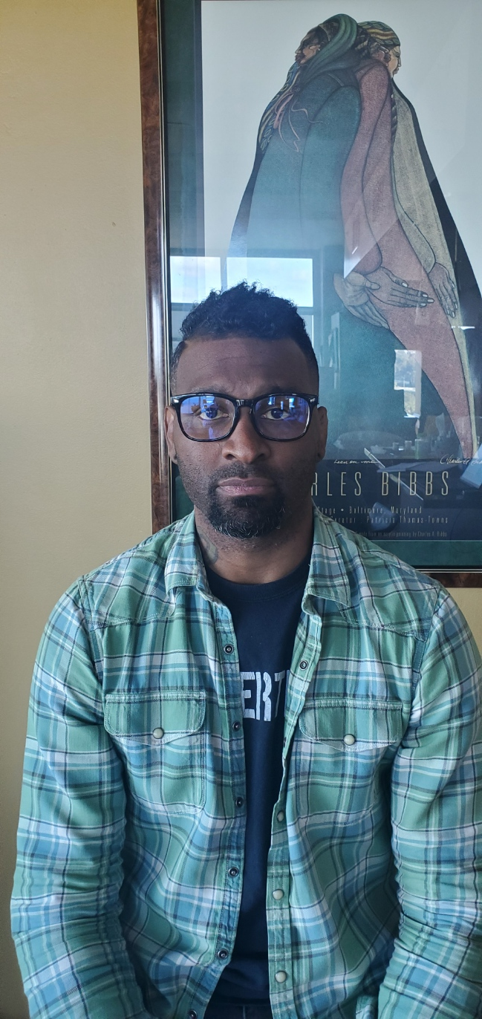

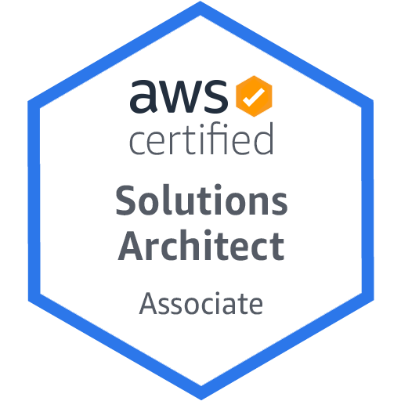

Antares L. Simensis
University: University of California, San Diego
Major: Joint Mathematics and Economics
Certifications: AWS Solutions Architect Associate
Cisco Certified Network Associate
Technology Competency
IntelliJ, VSCode, Java 8, JavaScript, TypeScript, Apache Tomcat, Catalina, Javalin, Node.JS, Express.JS, Hibernate, PostgreSQL, AWS RDS, Jackson Java Library, Log4j, Maven, TDD, Junit, Git
Work Experience (if any):
I have worked in a variety of capacities: Network Administrator, farmer, cocktail bartender, consulting math teacher, beverage consultant and, now, aspiring software engineer. Throughout these experiences I have trained staff, coordinated maintenance windows, created custom products, given presentations and worked in large and small teams. Position notwithstanding, I am always driven to serve as a trusted authority, perform tasks efficiently an maintain productive relationships with internal and external clients.
JAVA Full Stack Developer Program @ Revature (Sep’21 – Nov’21):
Learning how to leverage the tools, technologies and design patterns necessary to building robust end to end applications. Additionally, we have undergone training in DevOps techniques and Agile methodologies required to effectively manage projects.
Project 0
Console application with data persistence in an MVC pattern, Java 8, JDBC, Junit, PostgreSQL, RDS, JUnit
Project 1
Full stack application using classic front-end development technologies: Java 8, Javalin, JDBC, PostgreSQL, RDS, HTML, CSS, JavaScript, JUnit
Project 2
Full stack application building from our previous experiences and using a front-end development framework: Angular, TypeScript, Java 8, Spring Framework, Hibernate, Jenkins, PostgreSQL, RDS, JUnit, Mockito

Slide 7
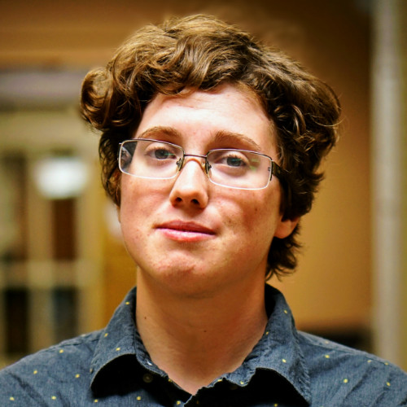

Asher Rosenbaum
University: Jacksonville State University
Major: Computer Science | Minor: Mathematics
University Projects/Internships
Front-End Development with GyreScope using NodeJS and AWS services
LTI App development and documentation authorship using Python, OAuth2, and PHP
Technology Competency
Java, Python, PHP, COBOL, PostgreSQL, MySQL, DevOps, Angular, Spring, and Microservices
Work Experience (if any):
Database Developer utilizing PHP, JavaScript, HTML/CSS, and MySQL
JAVA Full Stack Developer Program @ Revature (Sep’21 – Nov’21):
My time at Revature has sharpened my programming skills and focused me in on the major technologies and skillsets of the industry, such as AWS microservices, DevOps, Java Full Stack, Hibernate, Spring Boot, and Agile methodology.
Project 0
This project was a CLI banking app using JPA to connect to a PostgreSQL database hosted by AWS.
Project 1
In this project I created a website using vanilla JavaScript and HTML/CSS that took in reimbursement requests and persisted them to a PostgreSQL database via Hibernate.
Project 2
I worked with an Agile team for this project to create a learning assistant tool utilizing google’s Dialog Flow AI; we also created a testing module from scratch through the use of technologies such Hibernate, PostMan, Insomnia, Spring Boot, Angular, and Jenkins

Slide 8
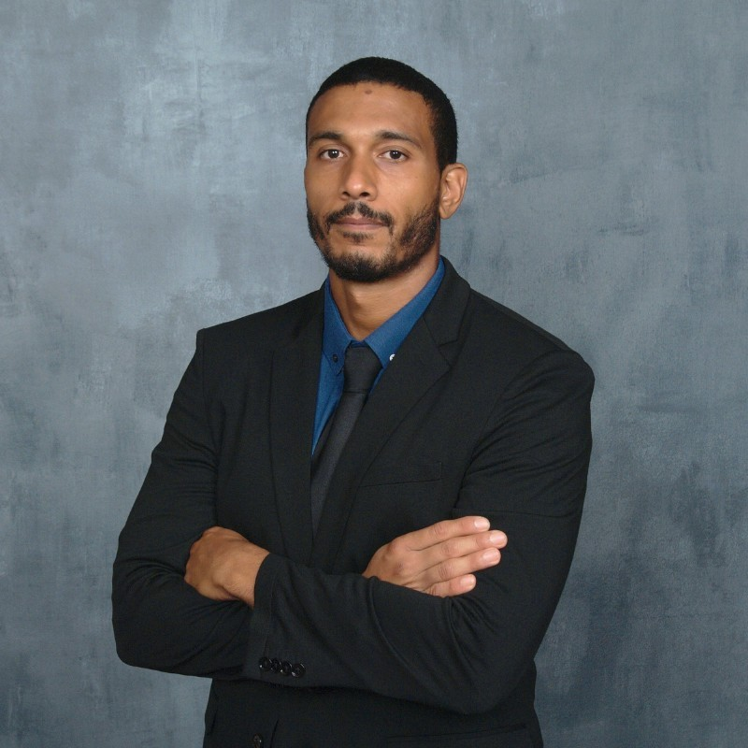

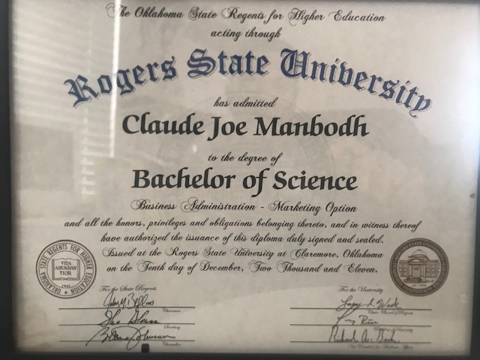
Claude Joseph Manbodh jr.
University: Rogers State University
Major: Business Administration – Marketing option
University Projects/Internships
- Business Administration – Marketing Option
Technology Competency
Java, SQL
Work Experience (if any):
ISP field technician, Dell Prop Support help desk position.
JAVA Full Stack Developer Program @ Revature (Sep’21 – Nov’21):
I have learned key concepts with Java such as OOP principals, SQL fundamentals and various Java tools to implement such as Spring and Hibernate.
Project 0
I was able to create a console application that properly updated a users financial amount when performing various actions such as deposits, withdrawals and transfers. This project helped me learn concepts such as Scanner, and method dependency.
Project 1
I attempted to make a Expense Reimbursement Web Application. I learned the importance of Data persistence and how to implement read and write operations from back end databases to front end applications such as Postman.
Project 2
I have been assigned DevOps responsibilities and have been learning how to configure and implement Jenkins with the automation of testing our source code from Gitlab.

Slide 9
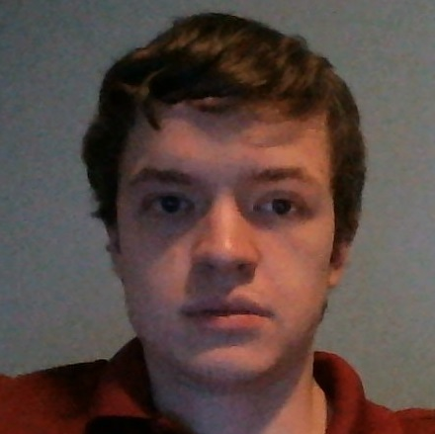

Jacob Jost
University: Santa Fe College
Major: Programming and Analysis
University Projects/Internships
Worked on a web application that received input from users, generated a PDF document, and emailed the document to the user using HTML, CSS, JavaScript, SQL, PHP, and C++.
Programmed a PLC using ladder logic for a prototype.
Technology Competency
Java, SQL, HTML, CSS, JavaScript, SQL, PHP, C++, C#, Spring, Hibernate, and Test-Driven Development
JAVA Full Stack Developer Program @ Revature (Sep’21 – Nov’21):
I have improved my experience with Java with techniques such as Test-Driven Development. I have also learned to use my experience to create web applications using Spring and Hibernate.
Project 0
Created a banking application using Test-Driven Development and SQL, allowing users to login to and manage their accounts.
Project 1
Created a web application in which an employee could log in and submit reimbursement requests using Hibernate.

Slide 10
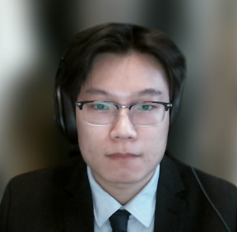

Jerry Zheng
University: Fordham University
Major: Computer Programmer
University Projects
Online Quiz Game (2019): An online quiz that tests the player’s ability to guess a movie based on its screenshots. The game is made with Node.js, Socket.io, Express. Web templates are made in HTML and styled with CSS.
Amazon Clone (2020): An Amazon Clone built with React.js and deployed on Firebase. The project covers all aspects of the online shopping experience including user registration, shopping cart, order history, and payments via the Stripe API.
Technology Competency
Java, SQL, DevOps, Angular, Spring and Microservices
Work Experience:
IT Assistant at Media Services, Fordham University (September 2016 – July 2021)
Maintained and managed media equipment for students and faculty. Reported and resolved technical issues from user tickets. Collected hardware and software information of media resources
JAVA Full Stack Developer Program @ Revature (Sep’21 – Nov’21):
Developed full stack projects on Spring framework and client-side single page applications. Implemented RESTful web services on server API endpoints to establish connection between client applications and the server
Project 0 - Banking Simulation
Created a simple Java console application with file system persistence.
Project 1 - Expense Reimbursement System
Designed and developed a web application hosted on a Javalin Server that communicates with PostgreSQL database
Project 2 - Feed - Cooking Community/Recipe Forum
Designed and developed a full stack application with Spring Boot with Angular Front-End

Slide 11
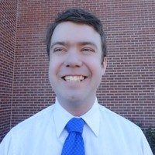

John Crofford
University: Southern Nazarene University
Major: Computer Science
| Minor: Mathematics, Philosophy
University Projects/Internships
Genetic Algorithms research at the University of Oklahoma using ECJ
AR software for NASA Johnson Space Center using C++ and DiSTI GL Studio
Technology Competency
Java, SQL, DevOps, Angular, Spring and Microservices
JAVA Full Stack Developer Program @ Revature (Sep’21 – Nov’21):
Personal Finance Management System
CLI application in Java with JDBC/PostgreSQL
Employee Reimbursement System
Online portal for submission, resolution, and status tracking with HTML/CSS/JavaScript, Java, Javalin, Hibernate, PostgreSQL
Community Cooking
Site for assisted recipe curation using Angular, HTML/CSS/Typescript, Spring Boot, Hibernate, PostgreSQL

Slide 12

Jordan Perez
College: Cuyamaca College
Major: Computer Science
Personal Projects
Infinite Space Shooter – Created with Unity Engine and C#.
Technology Competency
C#, Java, PostgreSQL, Hibernate, Spring, Angular, CSS, HTML, JavaScript
JAVA Full Stack Developer Program @ Revature (Sep’21 – Nov’21):
Throughout my training, I have learned many new technologies, including: Java, Spring, Hibernate, Angular, CSS, HTML, Servlets, and PostgreSQL.
Project 0
Using Java 1.8, JUnit, Log4j2, and PostgreSQL, I created a bank simulation console application that allows you to create users, deposit and withdraw money, track transactions, and persist all of the data to a remote SQL database.
Project 1
Created a front and back end web application using Java 1.8, HTML, CSS, and JavaScript which connects to a PostgreSQL database with POST and GET requests through Tomcat, which simulates an expense reimbursement system.
Project 2
As a team of four, we created a front and back end application that acts as an Issue Tracker, utilizing Java 1.8, Angular, Spring, Hibernate, and persisting data on a PostgreSQL database.

Slide 13
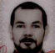

Jorge Ferreira
University: Penn State University
Major: Systems Engineering
University Projects/Internships
Risk Analysis (DecisionTree), FMEA, control charts.
Technology Competency
C#, DecisionTree, R.
Work Experience (if any):
Internal Quality Auditor – part of a team that certified a financial institution (ISO 9002).
Teacher – group management, presentation.
Procurement – participated in selection of PCB and driver developer. Goal was to develop an industrial temperature controller for building automation.
JAVA Full Stack Developer Program @ Revature (Sep’21 – Nov’21):
Java, JavaScript, TypeScript, CSS, HTML, Python, JUnit, Logging and SQL creating persistence, Spring Boot, Hibernate, Angular, Microservices.
Project 0
Console application simple banking simulation to create and update an account, with option for user creation.
Technologies: Java, Junit, log4j, PostgreSQL.
Project 1
Expense reimbursement system, to submit, review and prove/deny reimbursement requests.
Technologies: Java, servlets, JDBC, PostgreSQL, HTML/CSS/JavaScript, Junit, log4j.
Project 2
Issue Tracking System, tracker of bugs or other issues in product/service.
Technologies : Java, Hibernate, Spring Boot, Angular, Jenkins.

Slide 14
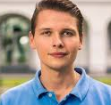
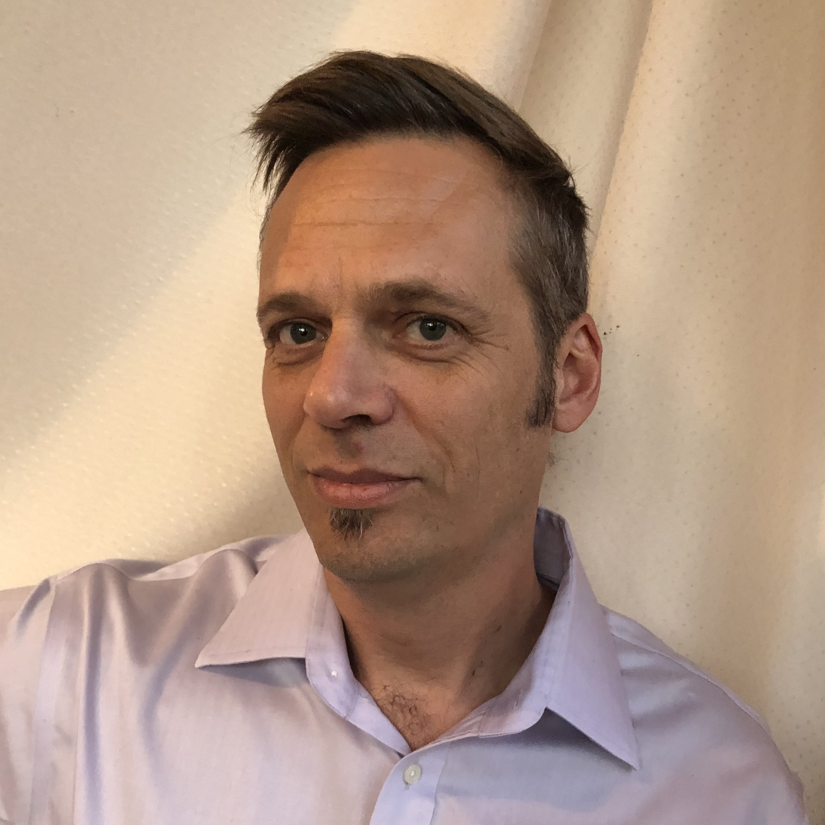



Martin Stenflo
University: University of Zurich, Switzerland
Major: Masters in Environmental Science
Certifications: Fullstack Software Engineer, App Academy
Technology Competency
Java, SQL, DevOps, Angular, Spring, Hibernate, Microservices, React, React Native, Redux, Ruby on Rails, PHP, SCSS, Node, Typescript, MongoDB, firebase, GCP, AWS, Jest, Enzyme, Junit, Arduino, Photoshop, Illustrator
Work Experience:
I have been involved with a number of startups, building responsive websites with PHP in WordPress and React, with Node, firebase, and mongoDB backends. I have been involved in all parts of the build process, from development to production to deployment. Coding is only one element in software production, I always find myself taking on project management and communication leadership roles when working in a team.
Aegis Studio (October 2020 – June 2021)
Fullstack Software Engineer – Contract work for various clients in React, Node, and WordPress.
Loxz Digital: (February 2021 – May 2021)
Frontend Developer – Lead frontend developer for machine learning startup.
Developed custom WordPress template in PHP
Implemented project management system for increased productivity

Slide 15
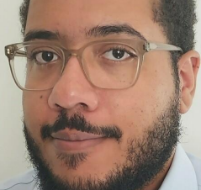

Paxton Plum
University: Western Michigan University
Major: Data Science
| Minor: Data Analysis
University Projects/Internships
My final project was a CS project making an automated system for watering and monitoring the growing conditions of herbs. Our task was to use a Raspberry Pi and a number of sensors to gather information used to send SMS alerts and create a user interface with growing conditions displayed.
Technology Competency
Java, SQL, HTML, CSS, DevOps, JUnit, Angular, Spring and Microservices
Work Experience
In my current position at Revature, I have studied full-stack Java development and microservices. I have applied this in several projects and delivered presentations on them.
In my previous position with Manpower, I worked as a freeze operator at Pfizer. I was responsible for loading of freezers and monitoring their temperature and function.
Before Manpower, I worked for Polytek Inc. as an assembler. I also carried out material handling duties.
JAVA Full Stack Developer Program @ Revature (Sep’21 – Nov’21):
I have studied full stack development with Java and Spring backend along with HTML, Angular, CSS, and SQL. I have applied these in a series of projects working towards the use of microservice architecture.
In Project0, I designed an app with a command line interface for using simple banking functions. The project employed Java and PostgreSQL. JUnit was used for testing and the final product was shown in a 5 minute presentation.
In Project1, I developed a web application for employee reimbursement with Java, HTML, CSS, JS, and PostgreSQL. The application allowed employees and managers to view pending and approved requests, submit requests, and login as well as log out. I also showed this to the batch in a 5 minute presentation

Slide 16

Peter Lalka
University: DePaul University
Major: Computer Security
University Projects/Internships
Basic security applications, networking analysis and security analysis.
Technology Competency
Java, SQL, C#, Scripting, Angular, Spring, Hibernate, Java, CSS, HTML, JavaScript, Jenkins, Docker, Spring, Angular, Tomcat
Work Experience:
BI Projects with Microsoft SQL, Oracle and other applications
JAVA Full Stack Developer Program @ Revature (Sep’21 – Nov’21):
Project 0
A basic console application. A user logs on with security features and accesses accounts. A teller manages accounts.
Project 1
A webserver that gives a user and manager access to expense requests and user/profile management.
Project 2
A calendar project that tracks tasks with managers and users. Messaging and other features are planned.

Slide 17
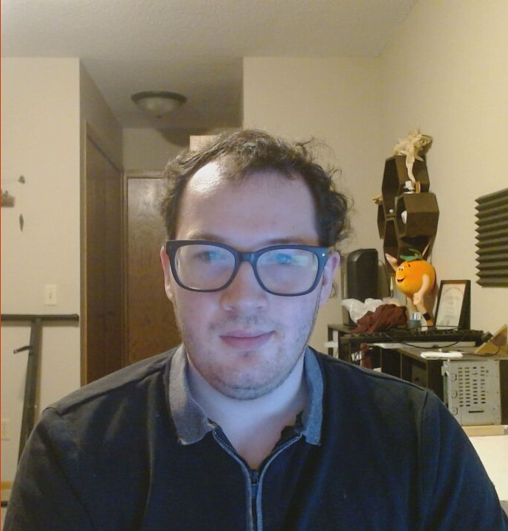

Ryan Mohler
University: St Cloud Technical and Community College
Major: Computer Programmer
University Projects/Internships
Final Project, Done in a group. We made a online card game with using NodeJS, HTML, CSS, JavaScript, with a shop in order to buy card packs.
Internship, The Ad Company. Made WordPress plugins in PHP
Technology Competency
Java, SQL, C#, HTML, CSS, JavaScript, NodeJS, Python, Linux
Work Experience:
Farm Service Agencey - Temporary Job. Helped sign people up for government programs related to the coronavirus
JAVA Full Stack Developer Program @ Revature (Sep’21 – Nov’21):
Learned how to make Java applications, and hook them up to a database using JDBC, or Hibernate. Learned how to use servlets in java as well as how to run a tomcat instance. Also learned Angular for use in single-page applications. Currently learning how to use spring to do dependency injection, and Spring MVC for web applications.
Project 0
Console Banking application written on my own in Java that persisted data to a AWS RDS PostgreSQL instance.
Project 1
Web based employee reimbursement system written on my own in Java, HTML, CSS, and JavaScript that allowed employees of a theoretical company submit requests for reimbursement.
Project 2
Web Based Issue Reporting system. I am currently responsible for working on the front end using Angular. The back end is written in Java using the spring framework.

Slide 18
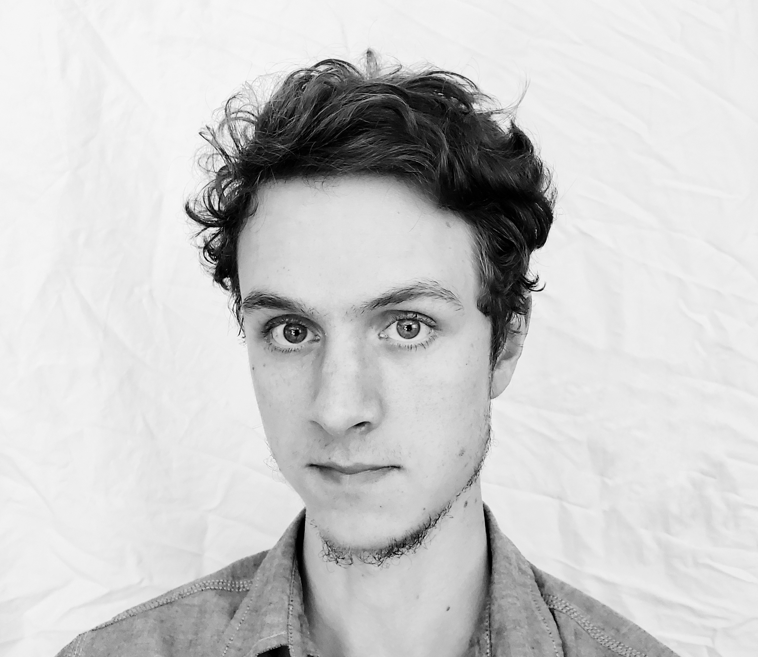

Samuel Lewis Jacobsen
University: New River Community College
Major: Associate’s in Information Technology
Certifications: MTA Introduction to Programming using Java, and JavaScript
University Projects/Internships
UnpackBND: Is a file extractor for parsing .bnd files on the windows platform
Technology Competency
Java, Batch, SQL, hibernate, TS, spring.
Work Experience:
Pre-prep Student Manager: Teach new students how to preform our dining services duties.
JAVA Full Stack Developer Program @ Revature (Sep’21 – Nov’21):
Project 0
Banking desktop application using Java, and SQL.
Project 1
Expense reimbursement web application using Java, SQL, Javalin, JS, HTML, CSS
Project 2
Task tracking calendar web application using Java, SQL, hibernate, spring boot, angular, AWS RDS, TS, Junit

Slide 19
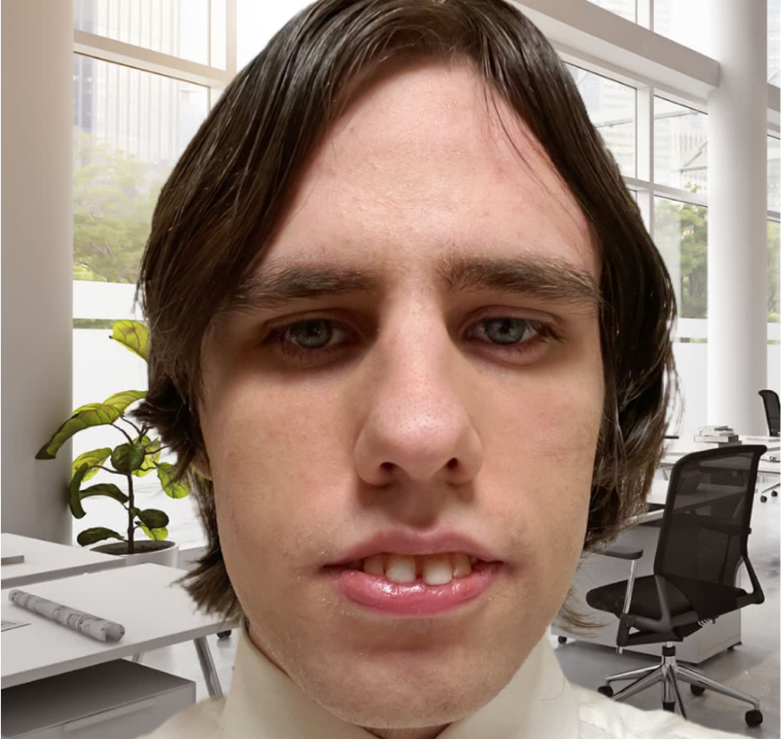

Timothy Harper
University: Austin Peay State University
Major: Computer Information Technology | Minor: Internet & Web Technology/Database Administration
University Projects/Internships
(Systems Analysis & Design Course): Worked on a team to build a web application that would facilitate web training for employees of a company.
Technology Competency
Angular 7, Java, Hibernate, TypeScript, JavaScript, PostgreSQL, SPRING framework.
Work Experience:
Worked for H1 Electrical Services, LLC to supply them with a company website. The website was to communicate the services the company offered, as well as how to contact the company. The tools used for the website were PHP, Vue.JS, MySQL.
JAVA Full Stack Developer Program @ Revature (Sep’21 – Nov’21):
Gained experience using Java to work with databases and front-end technologies.
Learned about and practiced the process of developing Single Page Applications(SPA).
Project 0
Utilized Java and JDBC to create a banking application that allowed for user login and transaction management.
Project 1
Created an Employee Reimbursement Application, which allowed users to log in to a reimbursement website and open/view tickets. For this project, JWT was used for user authentication and BCrypt was used for password hashing.
Project 2
Led the front-end development of a movie review website. Utilized Angular 7 to create a responsive SPA for the user.

Slide 20
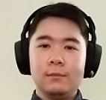

Vincent Wu
University: Rutgers University
Major: Political Science | Minor: Economics
Technology Competency
Java, SQL, HTML, CSS, JS, DevOps, Hibernate, Angular, Spring, Microservices
JAVA Full Stack Developer Program @ Revature (Sep’21 – Nov’21):
Since starting training, I have learned about OOP, Java, databases and data persistence, HTML and how to make an SPA, as well as Spring and Microservices
Project 0
Created a bank application that allowed for input of user data, along with the ability to filter users into customer and employee. Used Java, JDBC, SQL
Project 1
Created an SPA built on Project 0 that allowed the existing features but also includes new reimbursement features. Used Java, HTML, CSS, JS.
Project 2
Creating a movie review site with the ability to post reviews and add comments. Using Java, SQL, HTML, CSS, JS, Angular.

Slide 21
Java Full Stack curriculum
Project 0 –
Java, SQL, JDBC, Scanner
Project 2 –
Angular 4, Hibernate, Maven, Git, Associate DevOps pipeline, AWS, Spring Boot, Spring Data
Project 1 –
HTML, Servlet, Maven, Git, JavaScript, Hibernate, EC2, S3
Project 3 –
Spring Boot, Spring Data, Web Services, Trainer DevOps pipeline, AWS, Angular 4, Microservices
Week number
Week Topic
High Level Topics
Environment
Project
1
Java
Java, OOP Concepts, Unit Testing, Collections, Multi-threading, File I/O
JDK 1.8
JUnit 4.x+
Maven
Eclipse/IntelliJ
Project 0 – Individual project (Foundational Skills )
2
SQL/RDBMS
SQL Sublanguages, Normalization, Joins, JDBC, DAO Design Pattern, EC2, RDS
AWS RDS
PostgreSQL
Project 0 – Individual project (Foundational skills)
3
HTML/CSS/JavaScript & Servlet
HTML, CSS, JavaScript, Servlet, REST
AWS S3
Visual Studio Code
Project 1 – Individual project (Cloud & DevOps)
4
DevOps/Hibernate
Hibernate, AWS, CI/CD, Jenkins, SonarCloud, SonarLint
AWS
Jenkins
SonarCloud
Project 1 – Individual project (Cloud & DevOps)
5
Angular
npm, TypeScript, Angular
Angular 2.x+
Project 1 – Individual project (Cloud & DevOps)
6
Spring
Spring Core, MVC, ORM, Data, Boot, AOP
Spring 4.x+
Project 2 – Group Project (Tools)
7
Microservices
Web Services, Microservices, Discovery, API Gateway, Circuit Breaker, Messaging Queues, Config Server, Containers
Docker
Spring Boot 2.x+
Project 2 – Group Project (Tools)
8
Project 3
-
-
Project 3– Capstone Project (Group)
9
Project 3/Panel Interviews
-
-
Project 3– Capstone Project (Group)
10
Project 3/Showcase
-
-
Project 3– Capstone Project (Group)

Slide 22

For more information:
Alexa Gilroy
Email: alexandra.gilroy@revature.com

